Slide 1
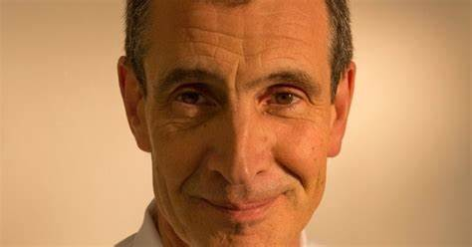
SHSK Discover Medicine evening on Thursday 16 January 2025 6:30pm Arrival 6:45pm Talk 7:15pm Refreshments
We would love to see you there. Please sign up to attend via this form: https://forms.office.com/e/7c93cwbkQS
Keynote Speaker: Professor Lawrence Impey Consultant in Obstetrics and Fetal Medicine at the JR

